Slide 1

East Tennessee Mental Health Resources
Help Me Find What I Need!
Welcome to East Tennessee Mental Health Resources.
Submit New
Resource
Search Resources
Search
Filter
Med MGMT
Therapists
Facilities
Student Resources
Resource 1
Resource 2
Admin Login
Resource 3
Resources 1-12

Slide 2
East Tennessee Mental Health Resources
Welcome to East Tennessee Mental Health Resources.
The long rectangle to the right represents a toggle bar function. This toggle bar is slightly scrolled down to reveal a search by address functionality
If you toggle down more, you may search by a zip with a radius
Filter
Student Resources
Search Address
Within 10 Miles
Within 20 Miles
Within 30 Miles
Filter
Search Zip
Within 10 Miles
Within 20 Miles
Within 30 Miles
Enter Zip
Enter Address

Slide 3

East Tennessee Mental Health Resources
Medication Management Providers
Help Me Find What I Need!
Submit New
Resource
Search Resources
Search
Filter
Med MGMT
Therapists
Facilities
Student Resources
Resource 1
Resource 2
Admin Login
Resource 3
Previous Page
Resources 1-12
Next Page

Slide 4
East Tennessee Mental Health Resources
Therapists
Help Me Find What I Need!
Submit New
Resource
Search Resources
Search
Filter
Med MGMT
Therapists
Facilities
Student Resources
Resource 1
Resource 2
Admin Login
Resource 3
Previous Page
Resources 1-12
Next Page

Slide 5
East Tennessee Mental Health Resources
Inpatient Facilities
Help Me Find What I Need!
Submit New
Resource
Search Resources
Search
Filter
Med MGMT
Therapists
Facilities
Student Resources
Resource 1
Resource 2
Admin Login
Resource 3
Previous Page
Resources 1-12
Next Page

Slide 6

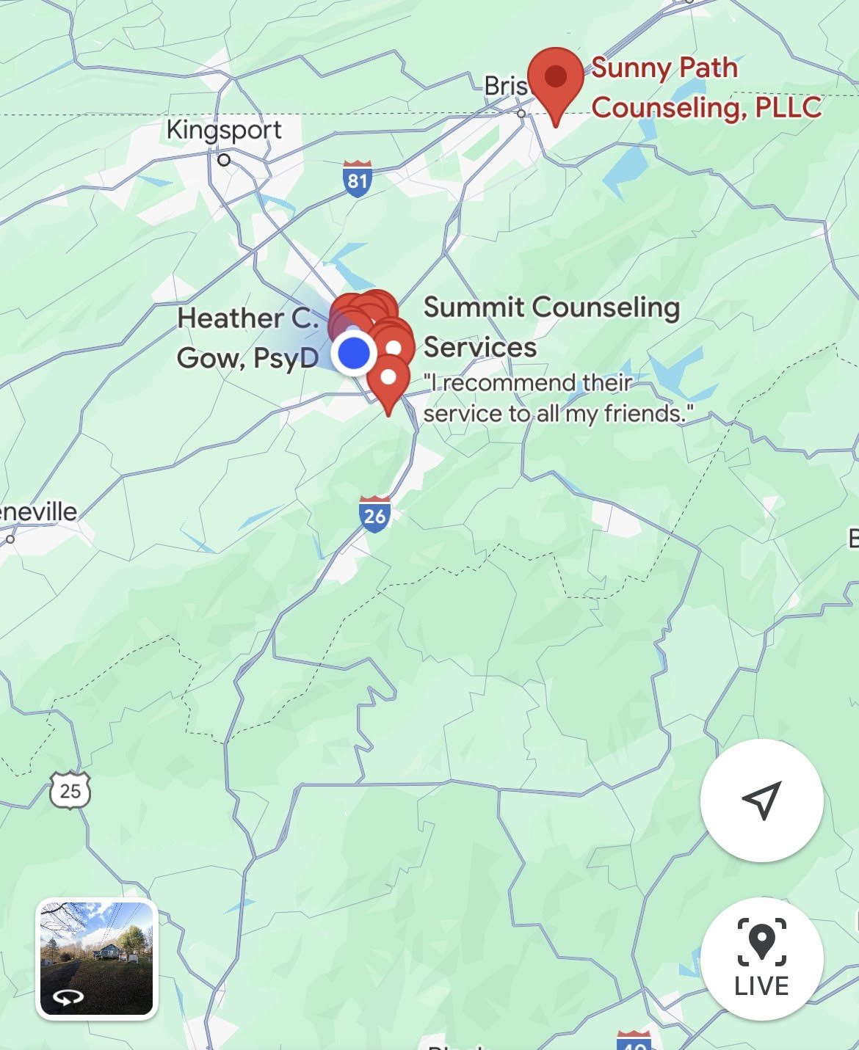
East Tennessee Mental Health Resources
Therapists
Help Me Find What I Need!
Submit New
Resource
Search Resources
Search
Filter
Med MGMT
Therapists
Facilities
Student Resources
Janine Hinkley
Licensed Professional Counselor
Associated Practice: Sunny Paths LLC.
123 Mockingbird Lane, Johnson City, Tennessee
Accepts Insurance: Yes
Insurances Accepted: Cigna, Aetna, BlueCross BlueShield
Phone: 555-555-5555
Admin Login
Back to Search
Back to Search

Slide 7
East Tennessee Mental Health Resources
Submit a New Resource
Back
What type of resource do you want to submit?
Search Resource Types
Search
Submit a Therapist
Search
First Name
Last Name
Therapist
Medication Management
Inpatient Facility
Outpatient Program
Student Related Resource
Address Line 1 Search/ Add
Address Line 2 Search/ Add
Associated Practice
Accepts Insurance
Yes
No

Slide 8

East Tennessee Mental Health Resources
Submit a New Resource
Back
What type of resource do you want to submit?
Search Resource Types
Search
Submit a Therapist
Search
First Name
Last Name
Therapist
Medication Management
Inpatient Facility
Outpatient Program
Student Related Resource
123 Mockingbird Lane |
Address
123 Mockingbird Ln, Suite 24 Johnson City, TN 37601
123 Mockingbird Ln, Suit 25 Johnson City, TN 37601
123 Mockingbird Ln, Suit 26
Notes:
When the user goes to enter the address for a new resource, the system will pull up official addresses from the postal service. When user selects an address, the address is simply stored with the new submission. If the new submission ends up being approved then the backend will check to see if this address is already present within the database with a unique ID. If it is present, the system will associate the already existing address from the address table with the new resource. If it is not then the system will create a new unique ID and add this new address to the address table. The system will add a foreign key to the address ID in the record for the new resource.

Slide 9
East Tennessee Mental Health Resources
Submit a New Resource
Back
What type of resource do you want to submit?
Search Resource Types
Search
Submit a Therapist
Search
Associated Practice Search/ Add
Therapist
Medication Management
Inpatient Facility
Outpatient Program
Student Related Resource
Accepts Insurance
Select Specialties
Yes
No
Athletes
Marriage
Students
OCD
GAD

Slide 10
East Tennessee Mental Health Resources
Submit a New Resource
Back
What type of resource do you want to submit?
Search Resource Types
Search
Submit a Therapist
Search
Side |
Assoc. Practice
Therapist
Medication Management
Inpatient Facility
Outpatient Program
Student Related Resource
Creekside LLC
Sunnyside LLC
Brightside LLC
Notes:
When a user goes to enter the associated practice, the system pulls up a search function which allows them to either select an existing practice from the database or a new practice from the database. This information is stored with the new resource submission.
If the new resource is approved, the backend will check if the practice exist in the database again. If the practice exists, the database will add a foreign key to the new resource record. If the practice does not exist then the system will generate a new unique ID and add the practice to the database. This is how we connect practices to providers. We also use a similar method for connecting addresses with other entities.

Slide 11
East Tennessee Mental Health Resources
Submit a New Resource
Back
What type of resource do you want to submit?
Search Resource Types
Search
Submit a Therapist
Search
Accepts Insurance
Select Specialties
Therapist
Medication Management
Inpatient Facility
Outpatient Program
Student Related Resource
Yes
No
GAD
Mood Disorders
Insurances Accepted
Aetna
Medicaid
Humana
Cigna

Slide 12
East Tennessee Mental Health Resources
Submit a New Resource
Back
What type of resource do you want to submit?
Search Resource Types
Search
Submit a Therapist
Search
Insurances Accepted
Therapist
Medication Management
Inpatient Facility
Outpatient Program
Student Related Resource
Insurance Company
Insurance Company
Submit Resource

Slide 13
East Tennessee Mental Health Resources
Submit a New Resource
Back
{INSERT SUBMITTED RESOURCE TYPE} Submitted For Approval!
Search

Slide 14

East Tennessee Mental Health Resources
Administrative Login
Log In
Email Address or Username
Password
Log In

Slide 15

East Tennessee Mental Health Resources
Administrative
New Requests
Past Requests
Sort
Ascending
Descending
Filter
Med MGMT
Therapists
Facilities
Student Resources
Approve
Deny
1. Janine Hinkley Therapist
2. Resource Facility
Approve
Deny
Approve
Deny
3. Resource Medication Provider
Previous Page
Resources 1-12
Next Page

Slide 16
East Tennessee Mental Health Resources
Administrative
New Request
Resource 1
Back to List
Janine Hinkley
Licensed Professional Counselor
Associated Practice: Sunny Paths LLC.
123 Mockingbird Lane, Johnson City, Tennessee
Accepts Insurance: Yes
Insurances Accepted: Cigna, Aetna, BlueCross BlueShield
Phone: 555-555-5555
Approve
Deny

Slide 17
East Tennessee Mental Health Resources
Administrative
Past Requests
New Requests
Sort
Ascending
Descending
Filter
Med MGMT
Therapists
Facilities
Student Resources
Approved
1. Janine Hinkley Therapist
2. Resource Facility
Denied
Approved
3. Resource Medication Provider
Previous Page
Resources 1-12
Next Page

